Slide 1
PBL MINI PROJECT
PROJECT NAME:
ERP SYSTEM AT HOSPITAL RECEPTION
TEJAS BHAME SYCOA31
LUBHAVAN BURGHATE SYCOA28
VINIT CHAUDHARI SYCOA34
SHIVAM BHENDEKAR SYCOA22
GUIDED BY:
DR.REENA KHARAT MAM

Slide 2
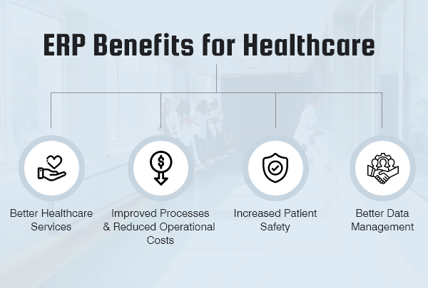
PROJECT DETAILS:
IT IS ERP SYSTEM FOR HOSPITAL RECEPTION MANAGEMENT.
IT STORES AND DISPLAY PATEINT DATA (NAME, PHONE NUMBER, AGE, ADDRESS)
BEDS / ROOM ALLOTMENT DONE BY THIS.
DISPLAYING CURRENT BEDS AND DOCTOR STATUS.

Slide 3
CONCEPT USED IN PROJECT
ARRAY OF OBJECT :In this program,array of object is used to store multiple patient data
SINGLE INHERITANCE : In this project,Hospital is the parent class and patient class is the base class which Is derived from hospital class.
STATIC VARIABLE :In this program ,static variables are bed and doctors which are mainting throughout the program.
STATIC FUNCTION:In this project,display hospital info is the static function used to maintain static variables beds and doctor.
EXCEPTION HANDLING :In this project ,exception handling is used to handle exception of accepting phone no. lees or more than 10 digits.(only to accept 10digit phone no)

Slide 4
IMPORTANCE
EASY TO USE AND ACCESS.
DATA CAN BE SAVED EFFECTIVELY WHICH CAN BE USED AFTERWORDS.
BETTER THAN WRITING IT MANUALLY ON PAPER.
INCREASED PATIENT SAFETY

Slide 5
ERP SYSTEM AT HOSPITAL
REPORT OF PARTICULAR PATIENT
HOSPITAL INFO
READ FUNCTION
DISPLAY HOSPITAL INFO
DISPLAY FUNCTION
ADMIT
CHECK UP

Slide 6
THANK YOU

